Slide 1
Lecture 4 Unit 4: Models of Curriculum Development B.Ed. (1.5 years) Semester I Subject: Curriculum Development Represented by: Ms. Sadia Tariq Department Of Education (Planning And Development) Lahore College For Women University, Lahore

Slide 3
INTRODUCTION
A Model can be defined as a simplified representation of reality. It simplifies by incorporating only those aspects of reality that interest the model builder.
Model suggests a representation of certain of a theory.
Models serve to structure systematic and logical thinking about curriculum, this entails:
identifying the relevant variables
Indicating their characteristics
Specifying their interrelationships, that is how they influence each other.

Slide 4
MODELS OF CURRICULUM DEVELOPMENT
Curriculum development has been looked at in two ways. These are basically process and product. Process is concerned with the methods and means how whereas the Product looks at the outcomes, the end product what. There are two approaches that have been developed, normative and descriptive.
The first approaches are called normative, objectives (Tyler1949) and the rational (Taba 1962 and Wheeler 1967) because they provide a sequence of steps. These have technical interests of control.
The procedural approaches,( Stenhouse 1975, Walker1972, Skilbeck1976, Olivia 1967) which falls into the second category of descriptive approaches, because it is an interactive model.

Slide 5
TYLER´S MODEL
The traditional model was laid out by Ralph Tyler in 1949 in his seminal book ´basic principals of curriculum and instruction´. And is generally considered the mainstream way to conceptualize curriculum development.
Tyler´s approach is seen as the linear model as well ad the ends mean model.
Tyler argued that curriculum development needed to be treated logically and systematically. His book attempted to explain a rational for viewing, analyzing and interpreting the curriculum and instruction program of an educational institution.

Slide 6
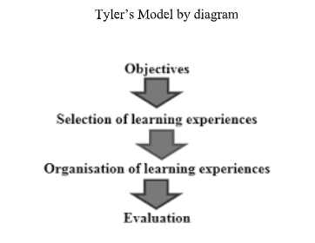

Slide 7
Cont..
Ralph Tyler considered four considerations in curriculum development:
Purposes of the school
Educational experiences related to the purposes
Organization of the experiences
Evaluation of the experiences
Tyler stated three important sources that must be look at in order to contextualize and make curriculum more relevant.
The learners and their backgrounds
Society
Knowledge of major disciplines especially philosophy, psychology and sociology

Slide 8
Cont..
From the three sources, curriculum planners derive general or broad objectives that lack precision and according to Oliva (1997) these are preferably called instruction goals. These goals may be pertinent to specific disciplines or may cut across disciplines.
Once this array of possibly applicable objectives is determined, screening process in necessary. According to Tyler´s model to eliminate educational and social philosophy as the first screen for these goals.

Slide 9
Cont..
Philosophical screen:
Tyler advised teachers of a particular school to formulate and educational and social philosophy. He urged them to outline their values and illustrated this task by emphasizing our democratic goals.
The recognition of the importance of every individual human being regardless of race, national, social or economic status.
Opportunity for wide participation in all phases of activities in the society.
Encouragement of variability rather than demanding a single type of personality
Faith in intelligence as a method of dealing with important problems rather than depending upon the authority of autocratic or aristocratic group.

Slide 10
Cont..
Psychological screen:
A psychology of learning not only includes specific and definite findings but it also involves a unified formulation of a theory of learning which helps to outline the nature of the learning process, hoe it takes place, under what conditions, what sort of mechanisms operate and the like.
Tyler explained the significance of the psychological screen:
Knowledge of the psychology of learning enables us to distinguish changes in human beings that can be expected to results from a learning process from those than can not.
Knowledge of the psychology of learning enables us to distinguish goals that are feasible from those that are likely to take a very long time or all almost impossible of attainment at the age level contemplated.

Slide 11
Strengths and weaknesses of objective´s model
weaknesses
strengths
Provides an easy to follow step by step guide, to curriculum planning and development.
Begins with the set of clear objective that teachers must plan tasks and work towards achieving the specified outcomes.
Sees curriculum development as a fixed, linear process.
Does specify where the objectives come from.
Limits what students can learn
Fail to recognize that the future can not be predicted accurately with precision.

Slide 12
TABA´S INVERTED MODEL
Hilda Taba believed that teachers who teach or implement the curriculum should participate in developing it. Her advocacy was commonly called the grassroots approach where teacher could have a major input. While still linear in approach, Taba argued for more information input at each stage of curriculum process.
She suggested a dual consideration of content and the individual learner.
Curriculum should be designed by the teachers.
An inductive approach which starts with the specifics and building up to a general design opposing the more traditional deductive approach of starting with general design and working down to specifics.

Slide 13
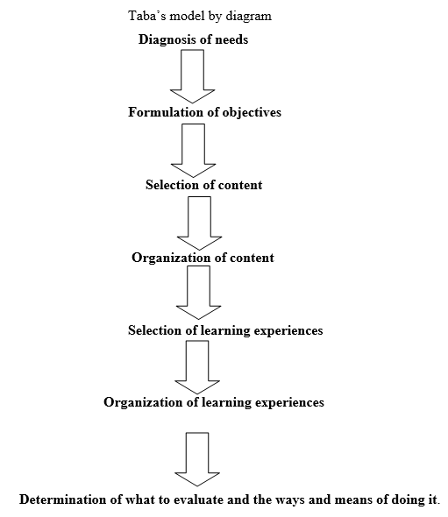

Slide 14
STEPS OF TABA´S MODEL
Diagnosing needs
Formulating specific objectives
Select content
Organization of learning content
Selection of learning experiences
Organization of learning activities
Determination of what to evaluate

Slide 15
WHEELER´S MODEL
Wheelers model for curriculum design is an improvement upon Tyler´s model.
It is a cyclical model in which evaluation provides the modifications of the first stages of curriculum development.
It gives an opportunity to the curriculum maker and educators to go back if the evaluation fails to achieve the specified objective or not to meet the purpose of learning.
The cycle must be done within 6 years only. If within 6 years and still fails, the curriculum design must now change.

Slide 16
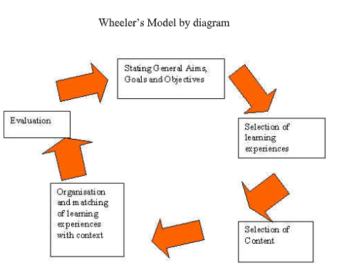

Slide 17
Cont..
Wheeler´s model contends that:
Aims should be discussed as behaviors referring to the end product of learning which yields the ultimate goals.
Aims are formulated from the general to specific in curriculum planning. This results in the formulation of objectives at both an enabling and a terminal level.
Content is distinguished from the learning experiences which determine the content.

Slide 18
Cont..
The Wheeler´s simple framework is:
The formulation of aims, goals and objectives.
The selection of learning experiences, determining the centres or focal points to be used for organizing these experiences.
The selection of content determining not only what subject matter should be covered but what mental powers and capacities such as thinking, skills and values should emerge from learning activities.
Organization and integration of learning experiences and content and methods to constitute a practical guide to action in the classroom.
Evaluation of the effectiveness of stage 2,3 and 4.

Slide 19
THE PROCEDURAL APPROACH
Interactions/ Dynamic models take into consideration the background and experience of students and teachers.
The curriculum elements are seen as flexible, interactive and modifiable.
Advocated by Walker, Skilbeck, Stenhouse, it sees the process of curriculum development as dynamic in nature.
Changes can be initiated from any point in the process unlike the objectives model where the beginning is always the setting of objectives.

Slide 20
Cont..
Walker´s model has three phases:
Platform: includes ideas, preferences, points of view, beliefs and values about the curriculum.
Deliberations: interaction between stakeholders begin clarification of views and ideas in order to reach consensus of a shared vision.
Design: curriculum developers actually make decisions which are based on deliberations. These decisions affect the curriculum documents and materials production.

Slide 21
Cont..
Stenhouse developed his model as a direct reaction to the objectives model.
Stenhouse sets process in achieving the learning goals and objectives of education.
The main focus is on teaching and learning and developing curriculum through practice rather than policy change. This is known as action research approach.
It identifies that teacher as the person most qualified to make the change.
Two core features: teacher research and reflective practice.

Slide 22
Cont..
Stenhouse has three processes: planning, empirical study and justification.
The focus of this model is that effective curriculum development is largely a matter of effective teachers' performance.
Central role is played by the teacher.
Teacher-centered learning.

Slide 23
NEED ASSESSMENT IN CURRICULUM DEVELOPMENT
Why assessment is necessary?
To provide information on pupil performance in gaining specified concepts, skills and attitudes.
To assist the diagnosis of learning difficulties.
To assist the evaluation of curriculum materials and teaching methods.
To enable schools to produce profiles of pupil performance.

